Slide 1
Inheritance
The process of creating a new class from existing classes is called inheritance.
The newly created class is called derived class and the existing class is called the base class.
The derived class inherits some or all of the characteristics of the base class.
Derived class may also possess some other characteristics which are not in the base class.

Slide 2
Advantages of Inheritance
1)Reusability
Reusability is an important feature of Object Oriented Programming.
We can reuse code in many situations with the help of inheritance.
The base class is defined and once it is compiled, it need not be rewritten.
Using the concept of inheritance the programmer can create as many derived classes from the base class as needed.
New features can also be added to each derived class when required.

Slide 3
2) Reliability and Cost
Reusability would not only save time but also increase reliability and decrease maintenance cost.
Saves Time and Effort
The reuse of class that has already been tested, debugged and used many times can save us the effort of developing and testing the same again.

Slide 4
Disadvantages of Inheritance
Inappropriate use of inheritance makes a program more complicated.
In the class hierarchy various data elements remain unused, the memory allocated to them is not utilized.

Slide 5
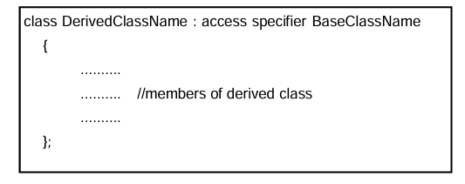
Defining a Derived Class
A derived class is defined by specifying its relationship with the base class in addition to its own details.
The general form of deriving a new class from an existing class is as follows:

Slide 6
The derived class name and the base class name are separated by a colon “:”.

Slide 7
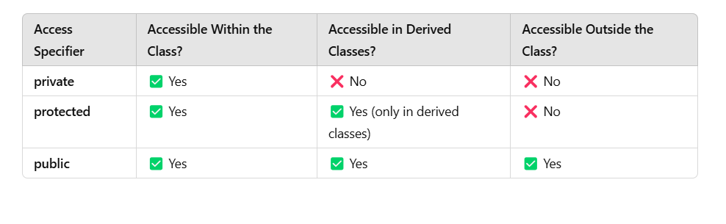
In C++, access specifiers control the visibility of class members (variables and functions) in different scopes.

Slide 8
Accessing Base Class Members
We can derive classes using any of the three base class access specifiers: public, private or protected.
If we do not specify the access specifier, then by default it will be private.
Generally, it is convenient to specify the access specifier while deriving a class.
Access specifiers are sometime called visibility mode.
It determines the access control of the base class members inside the derived class.

Slide 9
1)Public derivation
When the base class is inherited by using public access specifier then all public members of the base class become public members of the derived class, and all protected members of the base class become protected members of the derived class.
The private members of the base class remain private and are not accessible by members of derived class.

Slide 10
2) Private derivation
When the base class is inherited by using private access specifier, all the public and protected members of the base class become private members of the derived class.
Therefore, public members of base class can only be accessed by the member functions of the derived class and they are not accessible to the objects of the derived class.

Slide 11
3)Protected Members and Inheritance:
Protected members provide greater flexibility in case of inheritance.
By using protected instead of private declaration, we can create class members that are private to their class but that can still be inherited and accessed by derived class.
A member declared as protected is accessible by the member functions within its class and any class immediately derived from it.

Slide 12
When a protected member is inherited in public mode, it becomes protected in the derived class too and therefore is accessible by the member functions of the derived class.
It also becomes ready for further inheritance.
If a base class is inherited as private, then the protected member of base class becomes private in the derived class.
Although it is available to the member function of the derived class, it is not available for further inheritance since private members cannot be inherited.

Slide 13
Types of Inheritance
A program can use one or more base classes to derive a single class.
It is also possible that one derived class can be used as base class for another class.
Depending on the number of base classes and levels of derivation inheritance is classified into the following forms:
Single Inheritance
Multiple Inheritance
Hierarchical Inheritance
Multilevel Inheritance
Hybrid Inheritance
Multipath Inheritance

Slide 14
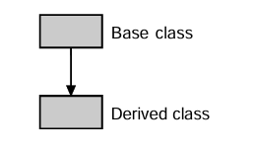
Single Inheritance
In single inheritance the derived class has only one base class and the derived class is not used as base class

Slide 15
The arrow directed from base class towards the derived class indi- cates that the features of base class are inherited to the derived class

Slide 16
Two different classes may have member functions with the same name as well as the same set of arguments.
But in case of inheritance, an ambiguous situation arises when base class and derived classes contain member functions with the same name.
In main(), if we call member function of that particular name of base class with derived class object, then it will always make a call to the derived class member function of that name.
This is because, the function in the derived class overrides the inherited function.
However, we can invoke the function defined in base class by using the scope resolution operator (::) to specify the class.

Slide 17
When a derive class implements a function that has the same name as well as the same set of arguments as the function in the base class, it is called function overriding.
When such a function is called through a object of derived class, then the derived class function would be invoked.
However, that function in base class would remain hidden.

Slide 18
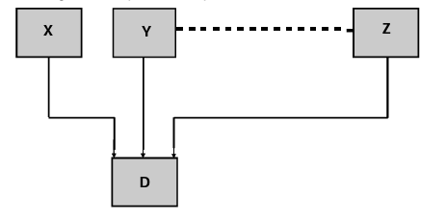
Multiple Inheritance
When one class is derived from two or more base classes then it is called multiple inheritance.
This type of inheritance allows us to combine the properties of more than one existing classes in a new class.

Slide 19
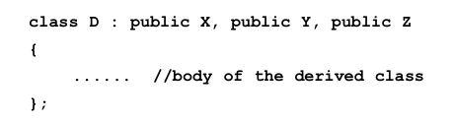
We have to specify the base classes one by one separated by commas with their access specifiers.
The general form of deriving a derived class from numbers of base class is as follows:

Slide 20
where X,Y, Z are base classes and D is the derived class.
There may be numbers of base classes in multiple inheritance which is indicated by the dotted line in the figure.

Slide 21
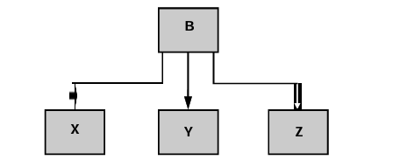
Hierarchical Inheritance
Derivation of more than one classes from a single base class is termed as hierachical inheritance.
This is a very common form of inheritance in practice.
The rules for defining such classes are the same as in single inheritance.

Slide 22
Multilevel Inheritance
C++ also provides the facility of multilevel inheritance, according to which the derived class can also be derived by an another class, which in turn can further be inherited by another and so on.
For instance, a class X serves as a base class for class Y which in turn serves as base class for another class Z.
The class Y which forms the link between the classes X and Y is known as the intermediate base class.
Further, Z can also be used as a base class for another new class. The following figure depicts multilevel inheritance.

Slide 23
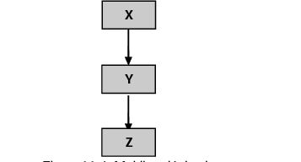

Slide 24
Hybrid Inheritance
It is possible to derive a class involving more than one type of inheritance.
Hybrid inheritance is that type of inheritance where several forms of inheritance are used to derive a class.
There could be situations where we need to apply two or more types of inheritance to design a particular program.

Slide 25
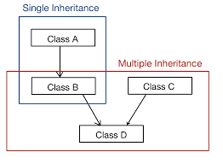

Slide 26
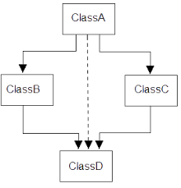
Multipath Inheritance

Slide 27
The inheritance where a class is derived from two or more classes, which are in turn derived from the same base class is known as multipath inheritance.

Slide 28
VIRTUAL BASE CLASSES
C++ provides the concept of virtual base class to overcome the ambiguity occurring due to multipath inheritance.
While discussing multipath inheritance, we have faced a situation which may lead to duplication of inherited members in the derived class .
This can be avoided by making the common base class as virtual base class while derivation.
When a class is made a virtual base class, C++ takes the necessary action that only one copy of that class is inherited, regardless of how many paths exist between the virtual base class and a derived class.

Slide 29
Polymorphism
The word polymorphism is a combination of two Greek words, poly and morphism.
“Poly” means “many” and “morphism” means “form”.
The functionality of this feature accords with its name.
Polymorphism is supported by C++, at both compile-time and at run-time.
Hence, there are two types of polymorphism: Compile-time Polymorphism Run-time Polymorphism

Slide 30
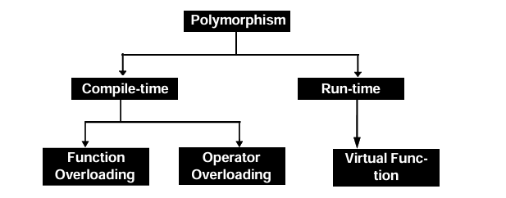

Slide 31
Function Overloading
With the help of function overloading, we can write different functions by using the same function name but with different argument lists.
The functon would perform different operations depending on the argument list in the functon call.

Slide 32
The overloaded member functions in case of function overloading are selected for invoking by matching the number of arguments and type of arguments.
This information is known to the compiler at the compile time itself and, therefore, the selection of the appropriate function is made at the compile time only.
In both cases, the compiler is aware of the complete information regarding the type and number of operands.
Hence, it is possible for the compiler to select a suitable function at compile time.
This is known as compile-time polymorphism. It is also termed as static binding or early binding.
Function overloading and Operator overloading are examples of Compile time polymorphism.

Slide 33
Operator Overloading
Operator overloading is achieved by allowing operators to operate on the user defined data type with the same manner as that of built- in data types.
For example, plus “+” operator produces different actions in case of integers, complex numbers or strings.

Slide 34
Unary Operator Overloading and Binary operator overloading are there

Slide 35
Binary Operator Overloading in C++
Binary operators operate on two operands.
In C++, we can overload binary operators in two ways:
Without Friend Function (Member Function)
With Friend Function (Non-Member Function)

Slide 36
Unary Operator Overloading in C++
Unary operators operate on one operand.
In C++, we can overload binary operators in two ways:
Without Friend Function (Member Function)
With Friend Function (Non-Member Function)

Slide 37
Binary Operator Overloading Without Friend Function
The binary operator is overloaded as a member function.
The left operand must be an object of the class.

Slide 38
Binary Operator Overloading Using Friend Function
The binary operator is overloaded using a friend function.
The function takes two objects as arguments.

Slide 39
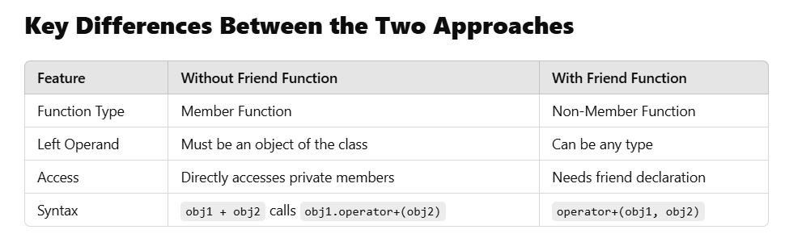

Slide 40
VIRTUAL FUNCTIONS
C++ supports a mechanism known as virtual function to achieve run-time polymorphism
A virtual function is a member function that is declared within a base class and redefined by a derived class.
The whole function body can be replaced with a new set of implementation in the derived class.
To make a function virtual, the virtual keyword must precede the function declaration in the base class.
The redefinition of the function in any derived class does not require a second use of the virtual keyword.
The difference between a non virtual member function and a virtual member function is that the non virtual member functions are resolved at compile time whereas the virtual member functions are resolved during run-time.
The concept of pointers to object is prior to knowing before implementing virtual function

Slide 41
Here, the function is linked with a particular class much later after the compilation and thus runtime polymorphism is also known as late binding or dynamic binding.

Slide 42
ABSTRACT CLASSES
The objects created often are the instances of a derived class but not of the base class.
The base class just becomes a structure or foundation with the help of which other classes are built and hence such classes are called abstract class or abstract base class.
In other words, when a class is not used for creating objects then it is called abstract class

Slide 43
PURE VIRTUAL FUNCTIONS
A pure virtual function is a virtual function that has no definition within the base class.
It only serves as a placeholder.
In such cases, the compiler requires each derived class to either define the function or redeclare it as pure virtual function.
A class containing pure virtual functions cannot be used to declare objects of its own.
Such classes are known as abstract base class.

Slide 44
A class that cannot instantiate objects is not useless.
We can create pointers to it and take advantage of all its polymorphic abilities.

Slide 45
Exception Handling
Exception handling in C++ is a mechanism to handle runtime errors gracefully and ensure that the program does not crash unexpectedly.
It allows us to "throw" exceptions when something goes wrong and "catch" them to handle the error properly.

Slide 46
Exception handling in C++ consist of three keywords: try, throw and catch:
The try statement allows you to define a block of code to be tested for errors while it is being executed.
The throw keyword throws an exception when a problem is detected, which lets us create a custom error.
The catch statement allows you to define a block of code to be executed, if an error occurs in the try block.
The try and catch keywords come in pairs

Slide 47
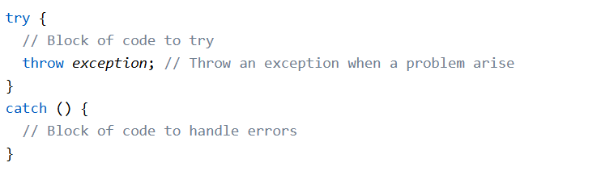

Slide 48
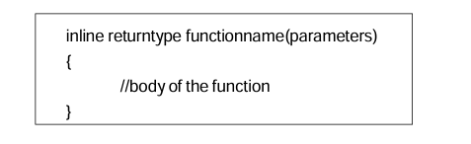
Inline Function
Function execution involves jumping of control from the calling program to called function.
This is an overhead for the program and increases the time in execution.
To eliminate this overhead, C++ provides a mechanism called inline function.
An inline function is a function that is declared with the keyword inline.
The keyword inline is a request to the compiler, to replaces the function call with the corresponding function body at the time of compilation.

Slide 49
OOP Concepts
Class
Object
Encapsulation
Abstraction
Inheritance
Polymorphism

Slide 50
Class
A class is a user-defined data type that serves as a blueprint for creating objects.
It encapsulates data members (variables) and member functions (methods) that operate on the data.
Vehicles ,Fruits etc are examples of class

Slide 51
Object
An object is an instance of a class.
It represents a real-world entity with properties (data members) and behaviors (member functions).
Mango is an object of the class Fruits
Car is an object of the class Vehicles

Slide 52
Encapsulation:
Hiding the implementation details and showing only the necessary functionality.

Slide 53
Abstraction
Hiding implementation details and showing only the necessary parts.

Slide 54
Inheritance
Mechanism to acquire properties of another class.
Types: Single, Multiple, Multilevel, Hierarchical, Hybrid.

Slide 55
Polymorphism
Ability of a function or object to take many forms.
Types: Compile-time (Function Overloading, Operator Overloading) and Runtime (Method Overriding).

Slide 56
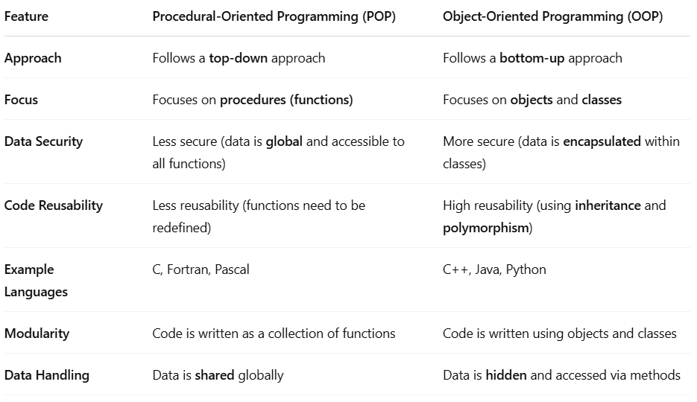
Difference between Procedural Oriented and Object Oriented Programming Languages

